Slide 1
Formatted console I/O operations
C++ supports many features to format the output and input
ios class functions and flags
Manipulators
User defined output functions (creating our own manipulators)

Slide 2
ios format functions
Function | task
width() | To specify the required field size for displaying output value
precision() | To specify number of digits to be displayed after the decimal point of float number
fill() | To specify a character used to fill the unused portion of a field
setf() | To specify format flags to control the form of output display like left justification etc
unsetf() | To clear the flags specified

Slide 3
width()
Used to define field width for the ouput of an item
It is a member function we need to use object to invoke
syntax : cout.width(w);
Here w is a number of columns. If the specified width is less than size of value c++ expands the field to fit value.
it can be applied to only one item after that it will revert back to the default
Eg: cout.width(5);
cout << 123 << 45<<endl;
cout.width(5); cout<< 123; cout.width(5); cout<< 45;
 |  | 1 | 2 | 3 | 4 | 5
 |  | 1 | 2 | 3 |  |  |  | 4 | 5

Slide 4
precision()
When outputting floating-point values, you can determine the number of digits of precision by using the precision( ) function.
Syntax: cout.precision(d);
Eg: cout.precision(3);
cout << 3.1234 << endl;
cout << 2.12345 <<endl;
The default precision is 6.

Slide 5
fill()
By default, when a field needs to be filled, it is filled with spaces.
We can specify the fill character by using the fill( ) function.
Its prototype is
char fill(char ch);
After a call to fill( ), ch becomes the new fill character, and the old one is returned.
Stays in effect till we change it

Slide 6
Formatting Using the ios Members
Each stream has associated with it a set of format flags that control the way information is formatted.
The ios class declares a bitmask enumeration called fmtflags in which the following values are defined.
adjustfield basefield boolalpha dec
fixed floatfield internal hex
left oct right scientific
showbase showpoint showpos skipws
unitbuf uppercase

Slide 7
When the skipws flag is set, leading white-space characters (spaces, tabs, and newlines) are discarded when performing input on a stream.
When skipws is cleared, white-space characters are not discarded.
When the left flag is set, output is left justified.
When right is set, output is right justified.
When the internal flag is set, a numeric value is padded to fill a field by inserting spaces between any sign or base character.
If none of these flags are set, output is right
justified by default.

Slide 8
By default, numeric values are output in decimal.
It is possible to change the number base.
Setting the oct flag causes output to be displayed in octal.
Setting the hex flag causes output to be displayed in hexadecimal.
To return output to decimal, set the dec flag.
Setting showbase causes the base of numeric values to be shown.
For example, if the conversion base is hexadecimal, the value 1F will be displayed as 0x1F.
By default, when scientific notation is displayed, the e is in lowercase. Also, when a hexadecimal value is displayed, the x is in lowercase.

Slide 9
When uppercase is set, these characters are displayed in uppercase.
Setting showpos causes a leading plus sign to be displayed before positive values.
Setting showpoint causes a decimal point and trailing zeros to be displayed for all floating-point output—whether needed or not.
By setting the scientific flag, floating-point numeric values are displayed using scientific notation.
When fixed is set, floating-point values are displayed using normal notation.
When neither flag is set, the compiler chooses an appropriate method.

Slide 10
When unitbuf is set, the buffer is flushed after each insertion operation.
When boolalpha is set, Booleans can be input or output using the keywords true and false.
Since it is common to refer to the oct, dec, and hex fields, they can be collectively referred to as basefield.
Similarly, the left, right, and internal fields can be referred to as adjustfield.
Finally, the scientific and fixed fields can be referenced as floatfield.

Slide 11
Setting the format flags
To set a flag, use the setf( ) function.
This function is a member of ios.
Its most common form is shown here:
fmtflags setf(fmtflags flags);
This function returns the previous settings of the format flags and turns on those flags specified by flags.
For example, to turn on the showpos flag, you can use this statement:
stream.setf(ios::showpos);
Here, stream is the stream you wish to affect.
***Notice the use of ios:: to qualify showpos. Since showpos is an enumerated constant defined by the ios class, it must be qualified by ios when it is used.

Slide 12
Clearing the format flags
unsetf( ) member function of ios is used to clear one or more format flags.
Its general form is
void unsetf(fmtflags flags);
The flags specified by flags are cleared. (All other flags are unaffected.)

Slide 13
Examining the flags
There will be times when you only want to know the current format settings but not alter any.
To accomplish this goal, ios includes the member function flags( ), which simply returns the current setting of each format flag.
Its prototype is shown here:
fmtflags flags();

Slide 14
Setting all flags
The flags( ) function has a second form that allows you to set all format flags associated with a stream.
The prototype for this version of flags( ) is shown here:
fmtflags flags(fmtflags f);
When you use this version, the bit pattern found in f is used to set the format flags associated with the stream.
Thus, all format flags are affected.
The function returns the previous settings.

Slide 15
Using manipulators to format I/O
The second way you can alter the format parameters of a stream is through the use of special functions called manipulators that can be included in an I/O expression.
Many of the I/O manipulators parallel member functions of the ios class.
Many of the manipulators were added recently to C++ and will not be supported by older compilers.

Slide 16
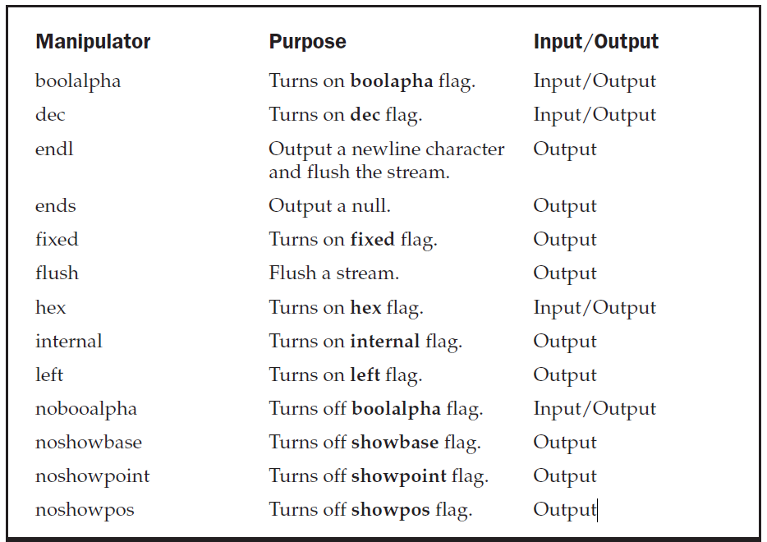

Slide 17
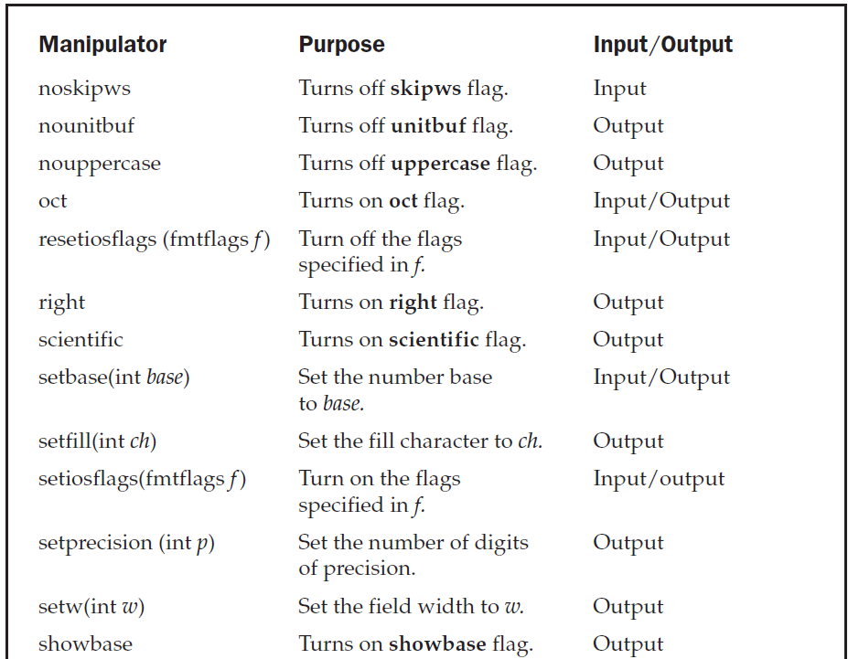

Slide 18
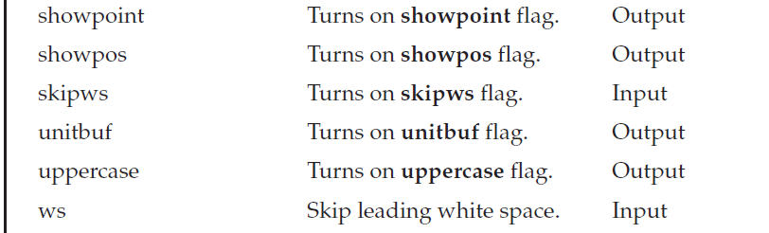

Slide 19
Creating our own manipulator
we can design our own manipulator for special purpose
The general form of manipulator without any args
ostream & manipulator (ostream & output)
{
-----------
--------
return output;
}
Eg: ostream & unit (ostream & output)
{
output<< “inches”;
return output;
}

